Slide 1


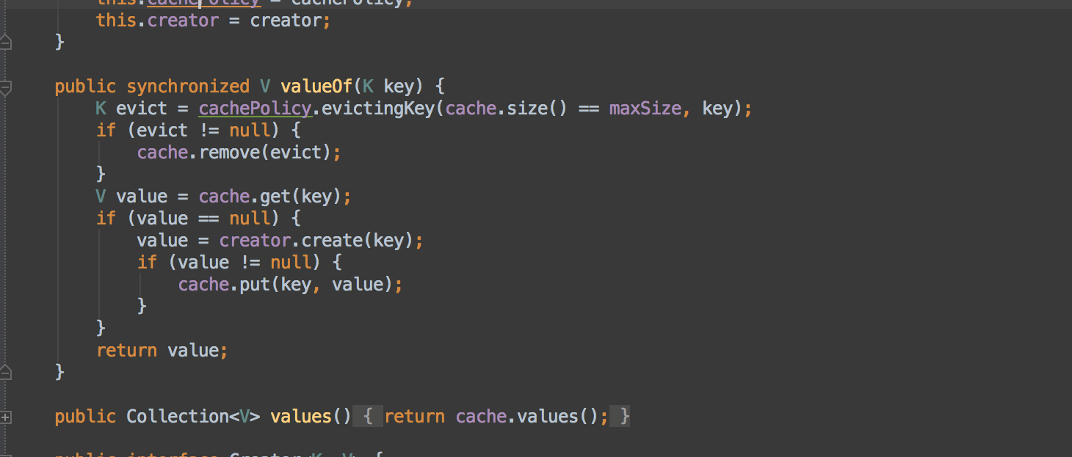


Functional Programming
Functions and Lambda Expressions
Advanced
Java
SoftUni Team
Technical Trainers
Software University
http://softuni.bg

Slide 2
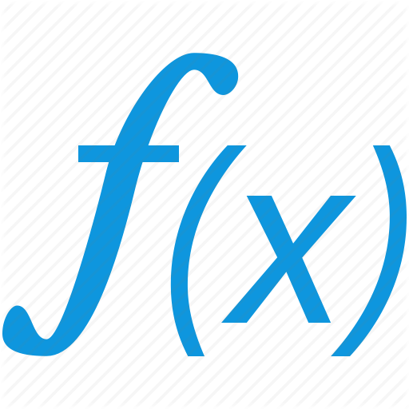


Table of Contents
Lambda Expressions
What is a Function?
Function<T,R>
Other Function Types
Consumer<T>
Supplier<T>
Predicate<T>
BiFunction<T, U, R>
Passing Functions to Methods

Slide 3
Questions
sli.do #JavaFundamentals

Slide 4
What is a Function?
Mathematic function
f(x) = x²
x
f(x)
Name
3 | 9
1 | 1
0 | 0
4 | 16
-4 | 16
Input
Output
A function is a special relationship where each input has a single output.

Slide 5

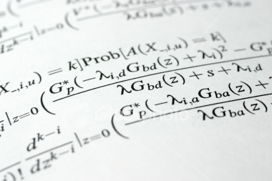
Lambda Expressions

Slide 6
Lambda Expressions
Lambda expression - unnamed function
Has parameters and a body
Use the lambda operator -> Read as "goes to"
Lambda Syntax
(parameters) -> {body}

Slide 7
Lambda Expressions (2)
Implicit lambda expression
Explicit lambda expression
(msg) -> { System.out.println(msg); }
Parameters can be enclosed in parentheses ()
The body can be enclosed in braces {}
String msg -> System.out.println(msg);
Declares parameters' type

Slide 8
Lambda Expressions (3)
Can have different number of parameters:
Zero parameters
More parameters
() -> { System.out.println("Hello!"); }
() -> { System.out.println("How are you?"); }
(int x, int y) -> { return x + y; }
(int x, int y, int z) -> { return (y – x) * z; }

Slide 9
Problem: Sort Odd Numbers
Read Integers from the console
Print the even numbers
Sort the even numbers
Print the sorted numbers
4, 2, 1, 3, 5, 7, 1, 4, 2, 12
4, 2, 4, 2, 12
2, 2, 4, 4, 12
Check your solution here: https://judge.softuni.bg/Contests/Practice/Index/463#0

Slide 10
Solution: Sort Odd Numbers
//TODO: Read numbers and parse them to List Of Integers
numbers.removeIf(n -> n % 2 != 0);
// TODO: Print the even numbers
numbers.sort((a, b) -> a.compareTo(b));
//TODO: Print the sorted numbers
Check your solution here: https://judge.softuni.bg/Contests/Practice/Index/463#0

Slide 11




Functions
Mathematical and Java Functions
Notes:
Functional programming is a programming paradigm
Uses computations of mathematical functions to build programs
Declarative programming paradigm (not imperative)
Pure-functional languages (no variables and loops): Haskell
Almost-functional: Clojure, Lisp, Scheme, Scala, F#, JavaScript
Imperative with functional support: C#, Python, Ruby, PHP, Java
Non-functional: C, Pascal, the old versions of C#, Java, C++, PHP

Slide 12
Java Functions
In Java we can create functions
Analogical to mathematical functions
f(x) = x²
Lambda Expression
Function<Integer, Intger> func = x -> x*x;
Input type
Output type
Name
Input parameter
Return expression

Slide 13
Function<T, R>
In Java Function<T,R> is an interface that accepts a parameter of type T and returns variable of type R
We use function with .apply()
int increment(int number) {
return number + 1;
}
Function<Integer, Integer> increment = number -> number + 1;
int a = increment.apply(5);
int b = increment.apply(a);

Slide 14
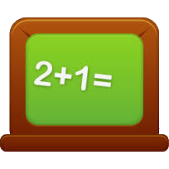

Problem: Sum Numbers
Read numbers from the console
Print their count
Print their sum
Use a Function
4, 2, 1, 3, 5, 7, 1, 4, 2, 12
Count = 10
Sum = 41
Check your solution here: https://judge.softuni.bg/Contests/Practice/Index/463#0

Slide 15
Solution: Sum Numbers
Scanner scanner = new Scanner(System.in);
String[] input = scanner.nextLine().split(", ");
Function<String, Integer> parser = x -> Integer.parseInt(x);
int sum = 0;
for (String s : input) {
sum += parser.apply(s);
}
System.out.println("Count = " + input.length);
System.out.println("Sum = " + sum);
Check your solution here: https://judge.softuni.bg/Contests/Practice/Index/463#0

Slide 16


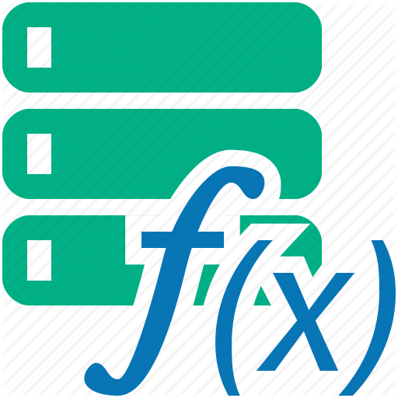
Practice: Lambda Expressions
Exercises in class (Lab)

Slide 17




Other Function Types
Special Functions
Notes:
Functional programming is a programming paradigm
Uses computations of mathematical functions to build programs
Declarative programming paradigm (not imperative)
Pure-functional languages (no variables and loops): Haskell
Almost-functional: Clojure, Lisp, Scheme, Scala, F#, JavaScript
Imperative with functional support: C#, Python, Ruby, PHP, Java
Non-functional: C, Pascal, the old versions of C#, Java, C++, PHP

Slide 18
Consumer<T>
In Java Consumer<T> is a void interface:
We use a Consumer with .accept():
void print(String message) {
System.out.println(message);
}
Consumer<String> print =
message -> System.out.print(message);
print.accept("pesho");

Slide 19
Supplier<T>
In Java Supplier<T> takes no parameters:
We use a Supplier with .get():
void genRandomInt()
Random rnd = new Random();
return rnd.nextInt(51);
Supplier<Integer> genRandomInt =
() -> new Random().nextInt(51);
int rnd = generateRandomInt.get();

Slide 20

Predicate<T>
In Java Predicate<T> evaluates a condition:
We use the Predicate with .test():
boolean isEven(int number) {
return number % 2 == 0;
}
Predicate<Integer> isEven = number -> number % 2 == 0;
System.out.println(isEven.test(6)); //true

Slide 21
Problem: Count Uppercase Words
Read text from the console
Find the words starting with an Uppercase letter
Print the count and the words
Use a Predicate
The following example shows how to use Predicate
2
The
Predicate
Check your solution here: https://judge.softuni.bg/Contests/Practice/Index/463#0

Slide 22
Solution: Count Uppercase Words
//TODO: Read text
Predicate<String> checkerUpperCase =
s -> s.charAt(0) == s.toUpperCase().charAt(0);
ArrayList<String> result = new ArrayList<>();
for (int i = 0; i < textAsList.length; i++) {
if (checkerUpperCase.test(textAsList[i])) {
result.add(textAsList[i]);
}
}
//TODO: Print results
Check your solution here: https://judge.softuni.bg/Contests/Practice/Index/463#0

Slide 23

Problem: Add VAT
Read some items’ prices from the console
Add VAT of 20% to all of them
1.38, 2.56, 4.4
Prices with VAT:
1,66
3,07
5,28
Check your solution here: https://judge.softuni.bg/Contests/Practice/Index/463#0

Slide 24
Solution: Add VAT
//TODO: Read input
List<Double> numbers = new ArrayList<>();
for (String s : input) {
numbers.add(Double.parseDouble(s));
}
Function<Double, Double> addVat = x -> x * 1.2;
System.out.println("Prices with VAT:");
for (Double str : numbers) {
System.out.println(String.format("%1$.2f",
addVat.apply(str)));
}
Check your solution here: https://judge.softuni.bg/Contests/Practice/Index/463#0

Slide 25
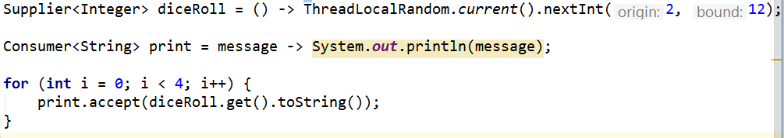
Practice: Other Function Types
Exercises in class (Lab)

Slide 26
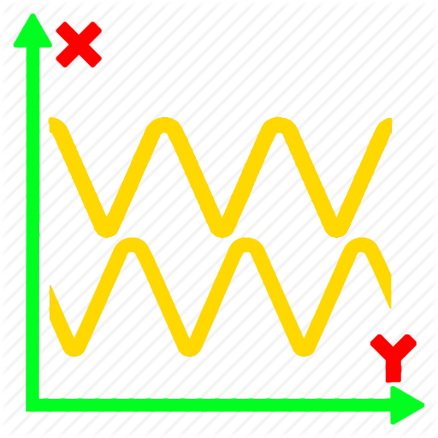
Bi Functions
Using Functions With More Parameters
Notes:
Functional programming is a programming paradigm
Uses computations of mathematical functions to build programs
Declarative programming paradigm (not imperative)
Pure-functional languages (no variables and loops): Haskell
Almost-functional: Clojure, Lisp, Scheme, Scala, F#, JavaScript
Imperative with functional support: C#, Python, Ruby, PHP, Java
Non-functional: C, Pascal, the old versions of C#, Java, C++, PHP

Slide 27

BiFunctions
BiFunction <T, U, R>
Analogically you can use:
BiConsumer <T, U>
BiPredicate <T, U>
BiFunction <Integer, Integer, String> sum =
(x, y) -> "Sum is" + (x + y);
Two input parameters

Slide 28
Problem: Sum Numbers
Read numbers from the console
Print their count
Print their sum
Use BiFunctions
4, 2, 1, 3, 5, 7, 1, 4, 2, 12
Count = 10
Sum = 41
Check your solution here: https://judge.softuni.bg/Contests/Practice/Index/463#0

Slide 29
Solution: Sum Numbers
//TODO: Read input
BiFunction<String, String, Integer> parser =
(x, y) -> Integer.parseInt(x) + Integer.parseInt(y);
int sum = 0;
for (int i = 0; i < input.length - 1; i + 2) {
sum += parser.apply(input[i], input[i + 1]);
}
System.out.println("Count = " + input.length);
System.out.println("Sum = " + sum);
Check your solution here: https://judge.softuni.bg/Contests/Practice/Index/463#0

Slide 30
Passing Functions to Method
We can pass Function<T,R> to methods:
We can use the method like that:
int operation(int number, Function<Integer, Integer> function) {
return function.apply(number);
}
int a = 5;
int b = operation(a, number -> number * 5); //b = 25
int c = operation(a, number -> number - 3); //c = 2
int d = operation(b, number -> number % 2); //d = 1

Slide 31
Problem: Filter by Age
Read from console n people with their age
Read a condition and an age so to filter them
Read format type for the output
Print all people that fulfill the condition
Pesho | 20
Gosho | 18
Radka | 29
Mara | 32
Izdislav | 16
Pesho | 20
Radka | 29
Mara | 32
Condition - "older"
Age - 20
Format - "name age"

Slide 32
Solution: Filter by Age
//TODO: Read info from the console
Predicate<Integer> tester = createTester(condition, age);
Consumer<Map.Entry<String, Integer>> printer =
createPrinter(format);
printFilteredStudent(people, tester, printer);
Check your solution here: https://judge.softuni.bg/Contests/Practice/Index/463#0

Slide 33
Solution: Filter by Age (2)
private static Consumer<Map.Entry<String,Integer>> createPrinter(String format)
switch (format)
case "name age":
return person -> System.out.printf("%s - %d%n", person.getKey(), person.getValue());
private static Predicate<Integer> createTester(String condition, Integer age)
switch (condition)
case "younger":
return x -> x <= age;
Add more cases
Check your solution here: https://judge.softuni.bg/Contests/Practice/Index/463#0

Slide 34
Solution: Filter by Age (3)
public static void printFilteredStudent(
LinkedHashMap<String, Integer> people,
Predicate<Integer> tester,
Consumer<Map.Entry<String, Integer>> printer) {
for (Map.Entry<String, Integer> person : people.entrySet()) {
if (tester.test(people.get(person.getKey()))) {
printer.accept(person);
}
}
}
Check your solution here: https://judge.softuni.bg/Contests/Practice/Index/463#0

Slide 35
Practice: Passing Functions to Methods
Exercises in class (Lab)

Slide 36
Summary
Lambda expressions are anonymous methods
Consumer<T> is a void function
Supplier<T> gets no parameters
Predicate<T> evaluates a condition
Function<T,R> is a function that returns R type
BiFunction<T, U, R> accepts two parameters
Functions can be passed like variables to methods

Slide 37







Functional Programming
https://softuni.bg/opencourses/algorithms

Slide 38





Trainings @ Software University (SoftUni)
Software University – High-Quality Education, Profession and Job for Software Developers
softuni.bg
Software University Foundation
http://softuni.foundation/
Software University @ Facebook
facebook.com/SoftwareUniversity
Software University Forums
forum.softuni.bg

